Slide 1

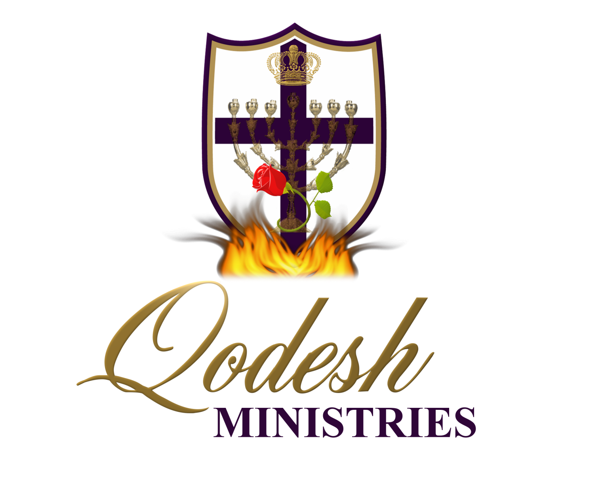

Slide 2
RECOGNITION
THE MESSIANIC PROPHECY BIBLE PROJECT
http://www.messianicbible.com
HEAR O ISRAEL
www.hearoisrael.org
SHEEPFOLD GLEANINGS WRITTEN BY JULIE PARKER
www.sheepfoldgleanings.com
MESSIANIC ISRAEL ALLIANCE
http://www.messianicisrael.com
AZAMRA TORAH FOR OUR TIME – RABBI AVRAHAM GREENBAUM
http://www.azamra.org

Slide 3
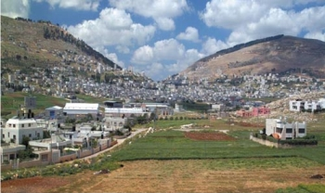
RE’EH “SEE”
TORAH: Deuteronomy 11:26-16:17
HAFTORAH: Isaiah 54:11-55:5
B’RIT CHADASHAH: John 3:36; 10:10, Acts 8-9; 1 John 4:1-6
All references: The Scripture 1998+ unless otherwise noted

Slide 4
THE RELIGION OF HUMANISM
All men must choose one of two paths to follow in life: to live a life in accordance with the Word of Elohim, or to rebel against the Word of Elohim and to live his life however he wishes. The philosophy of the former path causes a man to conform his life to the Word of Elohim and to walk in a healthy fear and respect of his Heavenly Creator, while in the latter man tends to conform the Word of Elohim to his image by picking and choosing what from יהוה’s Word suits him and tossing the rest. This course of action causes man to elevate his own thoughts above the Word of Elohim resulting in man worshipping himself, or the beauty or glory of his own thoughts. This is the religion of humanism where man is elevated to the place of deity and Elohim is demoted to a place of irrelevance or nothingness. The father of this religion is the devil who is the father of lies, and the Bible records the genesis of this religion in the account of the serpent deluding man through a series of lies (or half truths) at the Tree of Knowledge in the Garden of Eden. All the religions of the world trace their lineage back to secular humanism, except the true religion of the Bible. Even modern Christianity and modern rabbinic Judaism have absorbed many humanistic concepts.

Slide 5
RE’EH “SEE”: BLESSING AND CURSE
‘See, I am setting before you today a blessing and a curse: the blessing, when you obey the commands of יהוה your Elohim which I command you today; and the curse, if you do not obey the commands of יהוה your Elohim, but turn aside from the way which I command you today, to go after other mighty ones which you have not known. (Deuteronomy 11:26-28)
While “re’eh” means to “see”, it also means “to behold a vision” or “to envision”, and also “to consider” a matter, to “understand” or “comprehend” or “to regard” or “contemplate”, “to be seen” or “appear”, as well as “to show” or “be shown” something. In context it means “to look after” or “provide” and to “bring about” or “cause us to experience” either evil or good. We are to perceive the word in such a way as to understand that obedience:
Brings prosperity;
Produces spiritual transformation, and;
Progresses the believer to the point where he realizes the highest blessing is in the doing of the mitzvah.

Slide 6
RE’EH
Re’eh is spelt: “Reish – aleph – hey”.
“Reish” is the “head” or “beginning”.
“Aleph” is “the ox” and so is “strength” and/or “master”.
“Hey” is “the window” and means “revelation”.
So we get the picture “the beginning of strength is revelation”.
The numerical values of Re’eh is 206, Reish is 200, Aleph is 1 and Hey is 5. 206 also equals “debar” or the “word”, “dabar” or “to speak”. 206 is also the number of “a’rah” which is “to curse” and “bedar” meaning “to scatter”. In these verses, Elohim is indeed saying that, if B’nei Israel doesn’t obey Torah, He has spoken a curse to scatter them from off the Land.
If we are wise and obey His Torah, we will “see light”
Wisdom is good with an inheritance, and an advantage to those who see the sun. (re’eh ha shemesh, or see the light) (Ecclesiastes 7:11)

Slide 7
SEE
Ancient Israel was a culture of the ear, not the eye as there is no Biblical Hebrew word for “obey”. Instead, “shema” was used, indicating that we must “listen” to the “voice” of the Almighty with the intention of being obedient.
The definition the word “see” is not physically observing with your eyes, but a discerning sort of sight. The command to “see” means to not only open your eyes, but to open your mind. It means to grasp reality in the fullest sense. It also means don’t simply follow this way of life because it is all you know, or because it is convenient. Do it because you have come to “see” the vision, and because you believe in it.
The spiritual and the physical are always connected. Example: Messiah is Emmanuel….El (God) with us in the flesh and He is echad – One. Moses wanted the people to spiritually “see” that there would be real physical blessings or real physical curses that would occur in the real physical land into which they were about to go.

Slide 8
THE FATHER SEES
If we do not obey His Word, Hashem will turn His Face from us, as He did our fathers:
“But My people have forgotten Me, they have burned incense to what is false, and they have stumbled from their ways, from the ancient paths, to walk in bypaths and not on a highway, to make their land become a ruin, a hissing forever – everyone who passes by it is appalled and shakes his head. “I shall scatter them as with an east wind before the enemy; I shall show them the back and not the face in the day of their calamity.” (Jeremiah 18:15-17)
But if we repent and turn He will see our affliction:
And the people believed. And they heard that יהוה had visited the children of Yisra’ĕl and that He had looked (re’eh) on their affliction, and they bowed their heads and did obeisance. (Exodus 4:31)

Slide 9
יהוה SEES TO
A clear understanding of this concept can be found when Abraham takes Isak, the son of promise, to offer him as a burnt offering, as instructed by יהוה.
And Aḇraham took the wood of the burnt offering and laid it on Yitsḥaq his son. And he took the fire in his hand, and a knife, and the two of them went together. And Yitsḥaq spoke to Aḇraham his father and said, “My father!” And he said, “Here I am, my son.” And he said, “See, the fire and the wood! But where is the lamb for a burnt offering?” And Aḇraham said, “My son, Elohim does provide for Himself the lamb for a burnt offering.” And the two of them went together. (Genesis 22:6-8)
After the provision of the ram for the burnt offering, we read in verse 14 Avraham called the place Adonai Yir'eh [Adonai will see (to it), Adonai provides] — as it is said to this day, "On the mountain Adonai is seen.“
The Institute for Scripture Research folks use the term “יהוה Yireh” and KJV guys translated it as “Jehovah Jireh”. But, the Mazorites vowel pointed it to read “יהוה Ee’re’eh” for “יהוה Provides” or “יהוה Sees to”.

Slide 10
RE’EH - UNDERSTAND
“re’eh” also means to “understand” or “comprehend”. As Solomon said in Ecclesiastes 1:16:
So I spoke to my heart, saying, “See (Re’eh), I have attained greatness, and have gained more wisdom than all who were before me in Yerushalayim. And my heart has seen much wisdom and knowledge.”
But יהוה is with me like a mighty, awesome one. Therefore my persecutors shall stumble, and not prevail. They shall be greatly ashamed, for they have not acted wisely – an everlasting reproach never to be forgotten. But, O יהוה of hosts, trying the righteous, and seeing the kidneys and heart, let me see (Re’eh) Your vengeance on them, for I have revealed my cause to You.
(Jeremiah 20:11-12)

Slide 11
RE’EH “SEE” DELIVERANCE
David wrote of his victories and his defeats:
You who have shown me great and evil distresses, Revive me again and bring me up again From the depths of the earth. (Psalms 71:20)
And, as יהוה promises those who love Him:
“Because he cleaves to Me in love, Therefore I deliver him; I set him on high, Because he has known My Name. “When he calls on Me, I answer him; I am with him in distress; I deliver him and esteem him. “With long life I satisfy him, And show him My deliverance.” (Psalms 91:14-16)
This week He’s saying, “Behold, envision, consider, contemplate, understand and look after”. God causes us to experience the “blessing” and the “curse”, as we choose through our behaviour either obedience or rebellion. The Hebrew word used for “setting” is “natan” which means “to give” or “giving”. The word used here for “before” is “paniym” or “in front of your face”. יהוה has “given” or “set this decree”, so that it’s in front of us, so that we can contemplate it and understand it, and so on.

Slide 12
MOSES
Moses wanted the people to understand that their relationship with the Almighty was about choices that would affect their life in the here and now. These choices would have consequences – for blessing or for curses. Moses uses the imperative form of the verb for “see”. It is like the difference between being shown around a vegetable garden on a walking tour, versus spending a week working with the gardener. Moses wants the people to look carefully at these life choices and understand the consequences!
Understand that the spiritual and the physical are always connected. Messiah is the perfect example of this. He is Emmanuel….El (God) with us in the flesh and He is echad – One. Moses wanted the people to spiritually “see” that there would be real physical blessings or real physical curses that would occur in the real physical land into which they were about to go.

Slide 13
BE HEARERS AND DOERS
We know that faith comes by hearing, but faith without deeds (which can be seen) is not true faith:
So also belief, if it does not have works, is in itself dead. (James 2:17)
What we “see” physically is also important. Torah is meant to be more than head knowledge. By keeping the commandments of Torah we become a physical witness. A witness is one who can be “seen” by others. Here are the very last words of יהושע before His ascension:
“But you shall receive power when the Set-apart Spirit has come upon you, and you shall be My witnesses in Yerushalayim, and in all Yehuḏah and Shomeron, and to the end of the earth.” (Acts 1:8)
Someone who understood this relationship between “hearing” and being a witness to be “seen” was James, the brother of יהושע. Here is what he wrote:
And become doers of the Word, and not hearers only, deceiving yourselves. ... he that looked into the perfect Torah, that of freedom, and continues in it, not becoming a hearer that forgets, but a doer of work, this one shall be blessed in his doing of the Torah. (James 1:22-25)

Slide 14
SUMMARY
We have a man who “sees” his natural (his origin, his ancestral) face in a mirror. This man has been enlightened to his Hebrew roots. He has heard the message but does not “shema” by becoming obedient. He “forgets”… previous teaching we saw “forgetting” means that he strays away from Torah? Compare that with the man of verse 25 who looks (sees) into the perfect Torah of liberty and becomes a witness of the Torah. He is the one that receives the “blessing” because of the “choices” that he has made. James 1:22-25 is a midrash on Deuteronomy 11:26-27!
Our faith is based on “hearing” the words of יהוה. We have noted that one of the key words of Deuteronomy is shema, meaning to “hear” and to “obey”:
“Hear, O Yisra’ĕl: יהוה our Elohim, יהוה is one! (Deuteronomy 6:4)
It is in the carrying out of what we have “heard”, that the testimony or witness of our faith becomes something to be “seen”.

Slide 15
TODAY
The word “today” is found three times in Deuteronomy 11:26-28. In Hebrew “today” can just mean “this day” or it can have prophetic significance.
“See, I am sending you Ěliyah the prophet before the coming of the great and awesome day of יהוה. (Malachi 4:5)
That day is a day of wrath, a day of distress and trouble, a day of waste and ruin, a day of darkness and gloominess, a day of clouds and thick darkness,
(Zephaniah 1:15)
Moses is telling individuals to have the spiritual eyes to “see” that there will come a “day” in the future when the blessings or curses will apply to the “you all” of Israel. Yes, you can be blessed as an individual, but it is also very important to be part of the body of Israel. For now as an individual, align yourself with that part of Israel that attempts to keep the commandments of יהוה.

Slide 16
CHOICE
Thus the real “choice” for man is not just blessing or curse, but life or death. This “choice” has a very famous parallel that takes us clear back to the Garden of Eden:
And out of the ground יהוה Elohim made every tree grow that is pleasant to the sight and good for food, with the tree of life in the midst of the garden and the tree of the knowledge of good and evil. .. And יהוה Elohim took the man and put him in the garden of Ěḏen to work it and to guard it. And יהוה Elohim commanded the man, saying, “Eat of every tree of the garden, but do not eat of the tree of the knowledge of good and evil, for in the day that you eat of it you shall certainly die.” (Genesis 2:9-17)
Adam and Eve were given a “choice”. They were able to eat of every tree in the Garden, including the tree of “life”, EXCEPT the tree of the knowledge of good and evil. Eating of this tree would cause them to “die”! So they were given the “choice”! Life or death!
How could Adam and Eve have made such a bad choice? Don’t discount the power of the evil one who whispered in Eve’s ear, “Is that really what Yah said......?”

Slide 17
TREE OF LIFE
Just exactly what is the “tree of life”?
In the book of Proverbs, Solomon tells us that the Torah (associated with wisdom) is a tree of life:
She is a tree of life to those taking hold of her, And blessed are all who retain her. (Proverbs 3:18)
In Hebraic thought, when one accepts the teachings of Torah, it is said to “become a person’s flesh and blood.” Now you can understand what יהושע meant when He asked His disciples to partake of His “flesh and blood”. יהושע is the word of Yah, made flesh! In Him is life (like the tree of life)!
In the beginning was the Word, and the Word was with Elohim, and the Word was Elohim. He was in the beginning with Elohim ... In Him was life, and the life was the light of men. ... And the Word became flesh and pitched His tent among us, and we saw His esteem, esteem as of an only brought-forth of a father, complete in favour and truth. (John 1:1-14)
To recap what we have:
Life = Tree of Life = Torah = יהושע

Slide 18
EATING FROM THE TREE OF LIFE
When we accept יהושע as our Adonai and keep His commandments, then we have made the choice for life and blessings! Therefore we have seen that although the tree of life disappears after Genesis, we can still eat of the fruit of it through the keeping of Torah and the acceptance of יהושע! In a physical way, the tree reappears in the book of Revelation:
And he showed me a river of water of life, clear as crystal, coming from the throne of Elohim and of the Lamb. In the middle of its street, and on either side of the river, was the tree of life, which bore twelve fruits, each tree yielding its fruit every month. And the leaves of the tree were for the healing of the nations. (Revelation 22:1-2)
Now when we make the “choice” to follow יהושע, we must put aside our own impression of what He is like, and discover the truth about Him through the Torah. Deception is easy to accept because just as Adam and Eve fell into the trap set by the evil one, the deceiver always presents us with a god that fits into our own perception of what the Almighty should be like. He tickles our ears. He tells us what we want to hear.

Slide 19
NORROW GATE, DO NOT ENLARGE
“All the words I am commanding you, guard to do it – do not add to it nor take away from it. (Deuteronomy 12:32)
Since יהושע is the living Word, any change in the Word leads to a perverted picture of Messiah. When we live our life in accordance with a corrupted Word, others are no longer able to “see” יהושע through the witness of our obedience (shema). Making the “choice” to alter the
Word leads to cursing/death, not to blessing/life. יהושע pointed this out to his disciples:
“Enter in through the narrow gate! Because the gate is wide – and the way is broad – that leads to destruction, and there are many who enter in through it. “Because the gate is narrow and the way is hard pressed which leads to life, and there are few who find it. (Matthew 7:13-14)

Slide 20
FEAR
And Mosheh said to the people, “Do not fear, for Elohim has come to prove you, and in order that His fear be before you, so that you do not sin.” (Exodus 20:20)
In Hebrew thought fear of יהוה is knowledge. Knowledge and reverence of יהוה means intimacy with the Messiah through His Word. Fear was never to separate us from יהוה, that is what fear from an earthly nature does to יהוה’s people. We need to discover and put into practice holy fear from a heavenly nature and pursue after a walk in holiness.
If we still allow the sinful nature (as evident by our actions and speech) to operate in our lives, we have not entered into repentance and been converted. We cannot skip over the gate (covenant) to enter the kingdom of Heaven. Even though we are born again, we cannot enter with sin still on us (Revelation 22:12-16).
Everyone hating his brother is a murderer, and you know that no murderer has everlasting life staying in him. (1 John 3:15)

Slide 21
WHEN YOU OBEY
‘See, I am setting before you today a blessing and a curse: the blessing, when you obey the commands of יהוה your Elohim which I command you today; and the curse, if you do not obey the commands of יהוה your Elohim, but turn aside from the way which I command you today, to go after other mighty ones which you have not known. (Deuteronomy 11:26-28)
1st If: 'ăsher: A primitive relative pronoun (of every gender and number); who, which, what, that; also (as adverb and conjunction) when, where, how, because, in order that, etc.: - X
2nd If: eem: A primitive particle; used very widely as demonstrative, lo!; interrogative, whether?; or conditional, if, although; also Oh that!, when; hence as a negative, not
The first if actually translated into “when you obey” talking about a time when all of Israel will obey the Word of God.

Slide 22
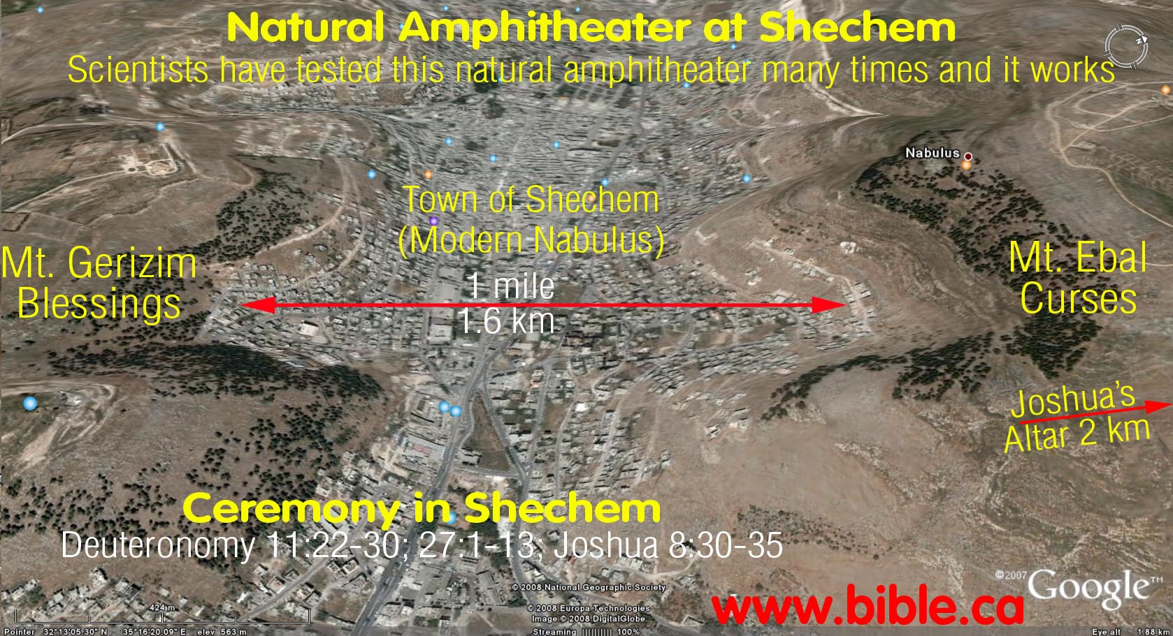
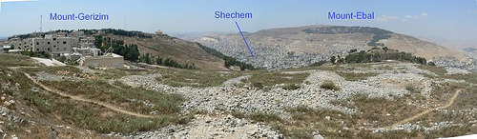
MOUNT-GERIZIM & MOUNT-EBAL
‘And it shall be, when יהוה your Elohim has brought you into the land which you go to possess, that you shall put the blessing on Mount Gerizim and the curse on Mount Ěyḇal. ‘Are they not beyond the Yardĕn, toward the setting sun, in the land of the Kenaʽanites who dwell in the desert plain opposite Gilgal, beside the terebinth trees of Moreh?
(Deuteronomy 11:29-30)

Slide 23
BLESSING - GERIZIM
The word for “blessing” used here is “B’racha”, Strong’s #1293 (beit-reish-kaf-hey) which also means gift or present. The Israelites were to place this blessing, this gift on Mt. Gerizim that is why it is referred to as the “Mountain of Blessing”. So, it should rightly be “Har Bracha”. There’s is a settlement near the top of Mt. Gerizim called Har Bracha.
The word “Gerizim”, Strong’s #1630, literally means “those cut off”. It’s from the root word “ger” meaning “stranger”. So, the “blessing” was placed, by Israel on the Mountain of “Those Cut Off”. In other words, Elohim had our “fathers” bless us in the Diaspora before we were ever dispersed; if we would come to obedience.
NOTE: After the Northern Kingdom, was taken into captivity, the Samaritans (a mixture of Israelites and other peoples taken captive by the Assyrians), would build their temple on that very mountain; a place of worship for a people “cut off”. The 600, or so, Samaritans still alive today, believe that Mt. Gerizim is where יהוה gave the Torah through Moshe. So, what יהוה and our fathers left for us, as a sign, in order to teach us the blessing of obedience, became a place of false worship.

Slide 24
CURSE - EYBAL
“Eybal” (Ayin-yud-beit-lamed) is Strong’s #5858 and literally means “without leaves” or “barren”, as in without fruit. It remains, today, barren and covered with whitish rocks and stones; devoid of life.
One cannot choose that which is holy (kodosh or set-apart) from that which is unholy (defiled or polluted) unless one knows what is holy and what is not. יהוה, not man, determines what is holy. יהוה outlines various times, places, things, actions and foods that are holy to Him by which his people can enter into holiness and holy communion with Him. There are holy times (יהוה’s annual festivals and the Sabbatical year), holy places (where יהוה places his name for his people to gather to worship him), holy food (clean verses unclean meats), holy income (our material income is sanctified or made holy through our tithing a portion to יהוה), holy lips (יהוה’s people are forbidden to allow the names of pagan deities to come on their lips), and יהוה’s people are to destroy any pagan, corrupting, defiling influences (the false gods of the heathens) by putting these things out of their lives.

Slide 25
SHECHEM
Shechem is located between the two mountains. The Hebrew word Shechem means “shoulder” or “back” (Strong’s H7927). The shoulder supports the head, which through the disposition of the mind and the direction in which the head is pointed, determines the path a person will walk whether good or evil. It was at Shechem, between the two mountains representing good and evil, that Israel renewed its covenant with יהוה before entering the Promised Land (Joshua 8:30–35). The power of the covenant that the people made with יהוה on that day thousands of years ago is still visible in the modern land of Israel: Mount Ebal is bare and devoid of vegetation, while Mount Gerizim is lush and green with foliage.
Israel renewed its covenant with יהוה at Shechem at the plains (or oak trees) of Moreh (Deuteronomy 11:30). This is the exact spot, at the entry point to the Promised Land, that יהוה had established his covenant with Abraham some 500 years earlier.
And Aḇram passed through the land to the place of Sheḵem, as far as the terebinth tree of Moreh. At that time the Kenaʽanites were in the land. (Genesis 12:6)

Slide 26
RIGHTEOUSNESS
Obedience to His gospel is righteousness; righteousness is holiness. It is the holiness part that forms the order of Melchizedek (king and priest) in the Davidic Covenant. Many do not realize that Moses’ words at Mount Sinai repairs the believer back into right order with יהוה to prepare him for the holiness of the priesthood in the Davidic Covenant. We cannot enter into the Davidic Covenant if we still have sinful issues operating in our lives (Colossians 3:5-10). If the commandment / principle / ordinance of יהוה given through Moses (Mosaic Covenant) is trespassed (broken), the principle then becomes a law against the one who broke it. Separation is repaired and fellowship restored if the lawbreaker repents. This is not a salvation issue, but a matter of holiness. Restoration is the gift of יהושע, through His death and resurrection. As His people, we are coming to understand that through obedience to His Word (at Mount Sinai, the Mosaic Covenant) and by incorporating this walk into a lifestyle, we begin to enter the Davidic Covenant in holiness and restore the order of Melchizedek/priesthood (Revelation 1:6).

Slide 27
LOCATION
‘Are they not beyond the Yardĕn, toward the setting sun, in the land of the Kenaʽanites who dwell in the desert plain opposite Gilgal, beside the terebinth trees of Moreh? (Deuteronomy 11:30)
The word “Yarden”, Strong’s #3383, means to “descend” or “flow down from”, as revelation. So, יהוה asks here, “Aren’t they (the blessing and the curse, or this promise) beyond the flow?” or “for a latter time?” The phrase “toward the setting sun” or “toward the sunset” alludes to the future, “End Times”.
The Hebrew word for “sun” is “shemesh”; Strong’s #8121 and is spelled the same as “Shamash” or the “Servant”, referring to Mashiach. And, the word used in this verse for “going down” or “setting” is the word “mabow”, Strong’s #3996, meaning “setting” or “to come in” or “enter”. In the remez, it hints at the “coming in or entering of Mashiach” in Hebrew thought. Then it says, “who dwell (literally “remain” in the Hebrew) in the land of the Kena’anites”. “Kena’anite” means “humble”. It’s for those who “remain humble” and “are in the wilderness” opposite, or in front of, as in “re’eh” or “seeing” or “contemplating” Gilgal.

Slide 28
LOCATION CONT.
Gilgal, Strong’s #1537 is translated “wheel” because it means “circle” or “a rolling away”. This is right out of the Book of Revelation, where John saw the heavens opened up, “rolled away” like a scroll. The Torah finishes the verse by saying, “beside the terebinth trees of Moreh”. The word for “terebinth tree” is “elown”, Strong’s #436, which means a “righteous” or “great” man. Moreh is Strong’s #4176 and means “teacher”.
Elohim is asking us here, as we read Verse 30, referring to the “blessing” placed on the “Mt. of Those Cut Off” and the “curse” being placed on the “Mt. of the Barren”, is that we will “see” this, “contemplate” this and “understand” this; and that we will “experience” this; in the “Day of יהוה”, when “Mashiach is about to enter”, if “we remain humble”, as we “remain in the plain, or wilderness”. And, we will “see the events of His revelation unfold”. Then we will be among the “terebinth trees” the “righteous” of “The Teacher”.

Slide 29
NAMES OF IDOLS
“And you shall break down their altars, and smash their pillars, and burn their Ashĕrim with fire. And you shall cut down the carved images of their mighty ones and shall destroy their name out of that place. (Deuteronomy 12:3)
As the ArtScroll Stone Edition Chumash points out, not only was Israel to remove the idols themselves, but they were not even to refer to them by their proper names (p. 1000). Rashi says that names of ridicule were to be coined for the pagan gods and used instead. He points out in his commentary on this verse that Jews would actually formulate derisive wordplay names based on the original names of the gods. For example, the pagan temple called, “the house of the crest” became “the house of the ditch” in that the words crest and ditch were similar in Hebrew. Or the idol “everyone’s eye” became “thorn in the eye.” The Second Jewish Revolt of A.D. 135 leader, Simon bar Kosiba, was given the name Simon bar Kochba (meaning “star”), but when his revolt failed at the hands of the Romans his detractors nicknamed him Simon bar Koziba meaning “Son of a Lie”

Slide 30
PLACES OF OFFERINGS
but seek the place which יהוה your Elohim chooses, out of all your tribes, to put His Name there, for His Dwelling Place, and there you shall enter. “And there you shall take your burnt offerings, and your offerings, and your tithes, and the contributions of your hand, and your vowed offerings, and your voluntary offerings, and the firstlings of your herd and of your flock. (Deuteronomy 12:5-6)
Moses was commanding that unlike the Canaanites who brought their offerings wherever they chose, Jews [Israelites] might do so only in places designated by יהוה. The Tabernacle at Shiloh, in the province of Ephraim, stood for 369 years--most of the period before the erection of the Temple--until it was destroyed by the Philistines at the end of Eli's tenure as Kohen Gadol and judge (see 1 Samuel 4:11-22). Chumash; Stone Edition, cp. 1000-1001.
We know where the place is: where his manifest glory and Presence is to be found to confirm that יהוה has placed his name there.

Slide 31
DAVID SOUGHT THE SET APART PLACE
O Elohim, You are my Ěl; I earnestly seek You; My being has thirsted for You; My flesh has longed for You In a dry and thirsty land without water. Therefore I have had a vision of You In the set-apart place, To see Your power and Your esteem. Because Your kindness is better than life, My lips do praise You. Therefore I bless You while I live; In Your Name I lift up my hands. (Psalms 63:1-4)
To see - “ra’ah” meaning literally “to see.”
Power - “might, power and strength.”
Glory - “kavod” (Strong’s H3519/TWOT 943 d, e) literally meaning “heavy or weighty”, “the visible manifestation of God” and his glory, often associated with his visible manifest Presence within the tabernacle (TWOT, vol. 2, p. 943).
Seen – “chazah” (Strong’sH2372/TWOT 633) meaning “to see as a seer/prophet in an ecstatic way with intelligence, to prophesy, to have a vision, to gain spiritual understanding.”
Sanctuary – “kodesh” and is the name of two rooms in the mishkan/tabernacle: the Kodesh (Set-apart/Holy Place) and the Kodesh haKodashim (Most Set-Apart Place/Holy of Holies).

Slide 32
PUTTING AWAY IDOLS
Then Yehoshua said to the people, “You are witnesses against yourselves that you have chosen יהוה for yourselves, to serve Him.” And they said, “Witnesses!” “And now, put away the mighty ones of the stranger which are in your midst, and incline your heart to יהוה Elohim of Yisra’ĕl.” (Joshua 24:22-23)
Joshua goes a step further and asks the Israelites to put away the foreign gods from among their very midst and clean up their hearts as they make the “choice” to serve Him. This doing away with idolatry is no different than the instructions given to the new believer who also must put away idolatry in order to provide a “place” for His Name:
Therefore put to death your members which are on the earth: whoring, uncleanness, passion, evil desire and greed of gain, which is idolatry. Because of these the wrath of Elohim is coming upon the sons of disobedience, in which you also once walked when you lived in them. But now, also put off all these: displeasure, wrath, evil, blasphemy, filthy talk from your mouth. Do not lie to each other, since you have put off the old man with his practices, and have put on the new one who is renewed in knowledge according to the likeness of Him who created him, (Colossians 3:5-10)

Slide 33
FINAL CHOICE
“If you do return, O Yisra’ĕl,” declares יהוה, “return to Me. And if you remove your abominations from My presence, and cease straying, and shall swear, ‘As יהוה lives,’ in truth, in right-ruling, and in righteousness – then nations shall bless themselves in Him, and they shall boast in Him!” For this is what יהוה said to the men of Yehuḏah and Yerushalayim, “Break up your tillable ground, and do not sow among thorns. “Circumcise yourselves unto יהוה, and take away the foreskins of your hearts, ... (Jeremiah 4:1-4)
The pattern of eradicating idolatry and anything not of יהוה continues in the book of Revelation. Finally יהוה takes things in His own hands and as a result of His mercy, people will have the opportunity to make a final “choice”.
And the Spirit and the bride say, “Come!” And he who hears, let him say, “Come!” And he who thirsts, come! And he who desires it, take the water of life without paying! (Revelation 22:17)

Slide 34
EATING BLOOD
“Only, be firm not to eat the blood, for the blood is the life, do not eat the life with the meat. “Do not eat it, you pour it on the earth like water. “Do not eat it, that it might be well with you and your children after you, when you do what is right in the eyes of יהוה. (Deuteronomy 12:23-25)
Why is this so important:
The life of every animal is in its “life-blood”, and if we eat meat with the life-blood still in it we ingest that animal’s life, including the animalistic behavior, mindset and nature of the type of animal we are eating. Those characteristics can manifest in our life and may lead us into compromised and idolatrous behavior, including fear, sexual immorality and occult activity (Numbers 25:1-3).
The reason we do not eat the blood is because יהוה asks us not to. Disobeying this commandment from יהוה will bring judgments (called curses) upon us that will pass from us to our children, and on to the third and fourth generation. We will be cursing our own children if we eat the blood.

Slide 35
JERUSALEM COUNCIL
but that we write to them to abstain from the defilements of idols, and from whoring, and from what is strangled, and from blood. (Acts 15:20)
Today many butchers stun the animal before killing them. Stunning the animal can lock the life-blood into the meat. The result is the same as a strangled animal. Fear, anxiety and shock sets into the animal and into the meat we then eat. These elements are what יהוה warned us against. Stunning the animal does not give the life-blood of that animal – with all its impure properties – an opportunity to be “poured out.” So whether we order from the butcher or choose meat in a restaurant we need to choose wisely so that it may go well for us and our children after us .
“Therefore say to them, ‘Thus said the Master יהוה, “You eat meat with blood, and you lift up your eyes toward your idols, and shed blood. Should you then possess the land? (Ezekiel 33:25)
יהוה mentions not eating the blood five times in Deuteronomy chapter twelve.

Slide 36
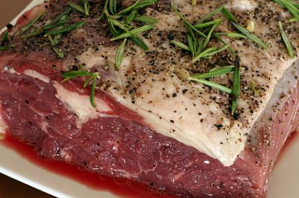
KOSHERING MEAT
If not sure this is how you Kosher-slaughtered meat. Place in a large bowl and cover completely with cool water; let soak 30 minutes. Drain. Completely cover all sides with kosher salt. Place meat on designated rack or cutting board (if using a board, have it tilted at an angle). Let stand 1 hour. Shake off salt. Thoroughly rinse meat twice with tap water.

Slide 37
FALSE PROPHET
“When there arises among you a prophet or a dreamer of dreams, and he shall give you a sign or a wonder, and the sign or the wonder shall come true, of which he has spoken to you, saying, ‘Let us go after other mighty ones – which you have not known – and serve them,’ do not listen to the words of that prophet or that dreamer of dreams, for יהוה your Elohim is trying you to know whether you love יהוה your Elohim with all your heart and with all your being. (Deuteronomy 13:1-3)
A prophet who entices other people to worship idols should be executed and an idolatrous city should be destroyed, dismantled stone by stone, and leveled. Idolatry is treason against יהוה.
According to Rashi, a sign is a supernatural event in heaven while a wonder is a miraculous event on earth. There are those among the people of יהוה who, as Adam Clarke states in his commentary on this verse, “pretend to have a Divine influence, so as to be able perfectly to direct others in the way of salvation” or shows some “miraculous proof of his mission … or some type of representation of what he wishes to bring you over to” (vol. 1, p. 774).

Slide 38
SIGNS AND WONDERS
What is this “test” about? Why is a “prophet” who does “signs and wonders” any different from Moshe who also performed “signs”? And more importantly, didn’t our Messiah also perform “signs and wonders”? Why should they have believed Him?
“Men of Yisra’ĕl, hear these words: יהושע of Natsareth, a Man from Elohim, having been pointed out to you by mighty works, and wonders, and signs which Elohim did through Him in your midst, as you yourselves also know, (Acts 2:22)
יהושע testified of the same “truth” fulfilled the “truth” of “grace”: for the Torah was given through Mosheh – the favour and the truth came through יהושע Messiah. (John 1:17)
יהושע’s disciples also did “signs and wonders” in accordance with the “truth”. This is why we can call them true prophets. Today a prophet must be judged by the same standards. Anyone who leads us away from Torah truths, even though they speak with “signs and wonders”, must be immediately eliminated as a true prophet.

Slide 39
THE TEST
But there also came to be false prophets among the people, as also among you there shall be false teachers, who shall secretly bring in destructive heresies, and deny the Master who bought them, bringing swift destruction on themselves. And many shall follow their destructive ways, because of whom the way of truth shall be evil spoken of, (2 Peter 2:1-2)
Peter tells us that false prophets may come out from among us and deny יהושע. The test of a false prophet according to Deuteronomy is not whether or not his prediction comes to pass. Rather, do his words line up with the truth of Torah? Remember that Pharaoh’s sorcerers were able to do many signs and wonders. A false prophet can display supernatural ability, so we must be able to use discernment. Without knowledge and understanding of the Word, we will not have discernment. We must be able to measure everything against the truth. This is one reason why it is good for us to be in community. If you are walking alone, you must know everything! Remember iron sharpens iron:
Iron is sharpened by iron, And a man sharpens the face of his friend. (Proverbs 27:17)

Slide 40
יהושע
Does יהושע fit the description of a false prophet? According to the picture that the mainline church has painted of Him, He does. The Jews have been correct in rejecting this “Jesus” that has been presented to them. He did do signs and wonders. Everything He said came to pass. But people have taught that He came to abolish the Word of Torah. Anyone who understands Torah, knows that one who speaks against Torah is automatically eliminated from qualifying as a true prophet. However the truth is, יהושע kept Torah perfectly. He took Torah to a deeper level and nothing He taught was opposed to it.
We have a “choice” that lays before us. It is the same for us as it was for the ancient Israelites. Joshua said it well:
“And now, fear יהוה, serve Him in perfection and in truth, and put away the mighty ones which your fathers served beyond the River and in Mitsrayim, and serve יהוה! “And if it seems evil in your eyes to serve יהוה, choose for yourselves this day whom you are going to serve, whether the mighty ones which your fathers served that were beyond the River, or the mighty ones of the Amorites, in whose land you dwell. But I and my house, we serve יהוה.” (Joshua 24:14-15)

Slide 41
APOSTLE PAUL: FALSE PROPHETS
For the secret of lawlessness is already at work – only until he who now restrains comes out of the midst. And then the lawless one shall be revealed, whom the Master shall consume with the Spirit of His mouth and bring to naught with the manifestation of His coming. The coming of the lawless one is according to the working of Satan, with all power and signs and wonders of falsehood, and with all deceit of unrighteousness in those perishing, because they did not receive the love of the truth, in order for them to be saved. And for this reason Elohim sends them a working of delusion, for them to believe the falsehood, in order that all should be judged who did not believe the truth, but have delighted in the unrighteousness. .. So, then, brothers, stand fast and hold the traditions which you were taught, whether by word or by our letter. And our Master יהושע Messiah Himself, and our Elohim and Father, who has loved us and given us everlasting encouragement and good expectation, through favour, encourage your hearts and establish you in every good word and work.
(2 Thessalonians 2:7-17)

Slide 42
APOSTLE JOHN: FALSE PROPHETS
Beloved ones, do not believe every spirit, but prove the spirits, whether they are of Elohim, because many false prophets have gone out into the world. By this you know the Spirit of Elohim: Every spirit that confesses that יהושע Messiah has come in the flesh is of Elohim, and every spirit that does not confess that יהושע Messiah has come in the flesh is not of Elohim. And this is the spirit of the anti-messiah which you heard is coming, and now is already in the world. (1 John 4:1-3)
The Apostle John wrote his epistle in an age when many false prophets had gone throughout the world, and he warned believers to be cautious about receiving a prophet too quickly, and supplied them with a test, which would absolutely determine their legitimacy. It serves the Body of Messiah to this day, assisting us in "seeing" who is and who is not of Elohim. Jude, the son of Alphaeus, also warned יהושע's people about wayward teachers and dreamers. He wrote, For certain men have slipped in, .. wicked ones perverting the favour of our Elohim for indecency, and denying the only Master יהוה and our Master יהושע Messiah…who come with forceful words, deceiving ministries with the underlying motive of coaxing and seducing believers away from "... belief which was once for all delivered to the set-apart ones. (Jude 1:3-4)

Slide 43
PEOPLE OF ADONAI
“You are the children of יהוה your Elohim. Do not cut yourselves nor shave the front of your head for the dead, for you are a set-apart people to יהוה your Elohim, and יהוה has chosen you to be a people for Himself, a treasured possession above all the peoples who are on the face of the earth. “Do not eat whatever is abominable. … (Deuteronomy 14:1-14)
Moses tells the sons of Israel that they are the children of the Most High Elohim. He suggests that the laws and regulations he sets forth are a reflection of that esteemed status. Self-mutilation is forbidden. Israelites would not be allowed to mourn by cutting and injuring themselves, a common practice among the Canaanites, and even witnessed today in Arab countries. Each Israelite was to be conscious at all times of his/her relationship with the Creator, with its blessings and responsibilities.

Slide 44
A TREASURED PEOPLE
We are to be the kadosh (set apart) and peculiar or treasured people of יהוה. We study, “eat” and live the Torah, the kadosh Word of Elohim, learning to live by the “whole counsel of the Word of Elohim” (Acts 20:27)
The term treasured people/am segulah is used several times in the Torah. Exodus 19:5–6 when יהוה betrothed himself to and married the people of Israel they became his am segulah or “treasured possession among all the peoples of the nation, a kingdom of priests and a kadosh/set-apart nation.” Moses restates this in Deuteronomy 26:17–19 where he again calls them his “treasured people” and admonishes them to keep his Torah-commands that he might “make you high above all the nations which he has made, in praise, and in name, and in honor, and that you may be a set-apart people unto יהוה your Elohim.”
But you are a chosen race, a royal priesthood, a set-apart nation, a people for a possession, that you should proclaim the praises of Him who called you out of darkness into His marvellous light, (1 Peter 2:9)

Slide 45
FIRST TITHE
‘And all the tithe of the land – of the seed of the land or of the fruit of the tree – belongs to יהוה. It is set-apart to יהוה. ‘If a man indeed redeems any of his tithes, he adds one-fifth to it. (Leviticus 27:30-31)
“And the first of all the first-fruits of all, and every contribution of all, of all your contributions, belong to the priests. And the first of your ground meal you give to the priest, so that a blessing rests on your house. (Ezekiel 44:30)
The first tithe was for the Kohan and Levites. We are commanded to bring in our tithe, or tenth, for Temple maintenance and for the Levites’ upkeep. The physical Temple is no longer; today the Temple is in us. Our temple is maintained if we give our tenth to those who are true Levites/shepherds looking after יהושע’s sheep according to His Word. According to Ezekiel 44, the tithe is to go to those who instruct on the clean and unclean, the holy and unholy, and who keep יהוה’s decrees, appointed feasts and Sabbath.

Slide 46
SECOND TITHE
“You shall tithe without fail all the yield of your grain that the field brings forth year by year. “And you shall eat before יהוה your Elohim, in the place where He chooses to make His Name dwell, .. so that you learn to fear יהוה your Elohim always…“At the end of every third year you bring out all the tithe of your increase of that year and store it up within your gates. “And the Lĕwite, because he has no portion nor inheritance with you, and the sojourner and the fatherless and the widow who are within your gates, shall come and eat and be satisfied, so that יהוה your Elohim does bless you in all the work of your hand which you do. (Deuteronomy 14:22-29)
Moses referred to the second tithe in this passage. The terumah (first fruit) and first tithe was set apart for the Kohen and levite. The second tithe was taken in the first, second, fourth, and fifth years of the seven-year cycle, called Shemittah. In the third and sixth year another (third) tithe was taken and distributed to the poor. No tithe was taken during the seventh year, as this was a year of rest for the land.
“At the end of every seven years you make a release of debts…. (Deuteronomy 15:1-19)

Slide 47
BLESSING FROM LISTENING
only if you diligently obey the voice of יהוה your Elohim, to guard to do all these commands which I am commanding you today. “For יהוה your Elohim shall bless you as He promised you. And you shall lend to many nations, but you shall not borrow. And you shall rule over many nations, but they do not rule over you. (Deuteronomy 15:5-6)
Moses said to the children of Israel, "...if you will hearken..." From the compound verb, the sages infer, 'If you hearken a little, you'll be permitted to hear a great deal' (Rashi). Usually, the reward for a mitzvah is the opportunity to repeat the performance of a similar commandment, thus, one who is careful to perform the commandment of tzitzis would be rewarded with beautiful clothing to which he can affix tzitzis." [Chumash, P.1017] The idea here presented is that the Torah gives ample opportunity for Israel to perform commandments and by so doing benefit materially and spiritually, by gaining deeper insights into its rich teachings and incentives to progress. This, then, will afford the righteous more opportunity for obedience, which in turn will bring forth even more abundant fruit. And so on. And יהושע said, Matthew 13:12 “For whoever possesses, to him more shall be given, and he shall have overflowingly; ..

Slide 48
PASSOVER, WEEKS, BOOTHS
“Guard the month of Aḇiḇ, and perform the Passover to יהוה your Elohim, for in the month of Aḇiḇ יהוה your Elohim brought you out of Mitsrayim by night. (Deuteronomy 16:1)
The imminent Jewish rabbi of the nineteenth century, Samson Raphael Hirsch, as to why we separate ourselves from the world during the three pilgrimage oraliyah festivals, said in his commentary on Deuteronomy 16:16:
[T]hree times in the year all the individual members of the nation [of Israel] are to appear out of all isolation personally before the Presence of the One God of the nation in the circle around the one common Sanctuary and thereby become conscious of each one being in connection with all the others, with God, and with His Torah.

Slide 49
SACRIFICIAL LIFESTYLE
יהושע .. is the same yesterday, and today, and forever. (Hebrews 13:8).
“And it shall be, that unto the place which יהוה your Elohim chooses to make His Name dwell there, there you are to bring all that I command you: . burnt offerings, .. offerings, .. tithes, .. contributions .. your choice offerings which you vow to יהוה. (Deuteronomy 12:11)
Thus said יהוה, “The heavens are My throne, and the earth is My footstool. Where is this house that you build for Me? And where is this place of My rest? (Isaiah 66:1)
Do you not know that you are a Dwelling Place of Elohim and that the Spirit of Elohim dwells in you? If anyone destroys the Dwelling Place of Elohim, Elohim shall destroy him. For the Dwelling Place of Elohim is set-apart, which you are. (1 Corinthians 3:16-17)
What, then, shall we say? Shall we continue in sin, to let favour increase? (Romans 6:1)
We still offer sacrifices on the altar. It is up to us to keep our hearts clean and stay pure in thought and deed. May we worship the Father in Spirit and in Truth, and may our tithe be offered from our hearts with joy. (John 4:19-24).

Slide 50
HAFTORAH READING: ISAIAH 44:11-45:5
44:10–20 This portion of Scripture reveals the folly of worshipping the created instead of the Creator (also Rom 1:18–25).
44:13 Makes it after the likeness of a man, according to the beauty [splendor, glory] of a man.
44:14 The rain nourishes it. That which makes something or contributes to something’s creation logically must be greater than the thing created.
44:20 He feeds on ashes. Worship of anyone or anything other than יהוה is considered feeding on ashes (nothingness) and is the product of a deceived heart.
44:21 You are my servant, O Jacob. Consider how it is preferable to be a servant of יהוה while worshipping the one true Creator compared to being a king and worshipping the spiritual idols of one’s own deceived mind.
44:22 I have blotted out … redeemed you. As the Righteous Judge of the universe, he has the ability to forgive us of our sins and to grant us eternal life. No religious systems on planet earth promise forgiveness and redemption.

Slide 51
HAFTORAH READING: CYRUS
44:28–45:1-5 Cyrus. This prophecy of Isaiah concerning Cyrus, the first king of the Persian empire, was made circa 712 b.c., which was more than 100 years before Cyrus was even born. Of this, Josephus, the first century Jewish historian, records that Cyrus purposed to restore the Jews to their land and to rebuild the temple in Jerusalem based on his “reading the book which Isaiah left behind him of his prophecies; for this prophet said that God had spoken thus to him in a secret vision, ‘My will is, that Cyrus, whom I have appointed to be king over many and great nations, send [sic] back my people to their own land, and build my temple.’ This was foretold by Isaiah one hundred and forty years before the temple was demolished. Accordingly, when Cyrus read this, and admired the divine power, an earnest desire and ambition seized upon him to fulfill what was so written” (Antiquities 11.1).

Slide 52
THE LIVING TORAH
“Do not think that I came to destroy the Torah or the Prophets. I did not come to destroy but to complete. (Matthew 5:17)
‘See, I am setting before you today a blessing and a curse: (Deuteronomy 11:26)
Our lives consist of moment-by-moment decisions; choices of alternatives. We can go right or left, stop or proceed, speak or be silent, follow יהושע or live for ourselves, and so on. Choosing is constantly required, even demanded, and the results of our choices are momentous! For our benefit, we glean lessons from ancient Israel's experience:
Understanding the will of Elohim [see 1 John 3:23] Every step we take along the road of obedience to His revelation is a step closer to the Almighty.
It is impossible to remain the same once we have come into the knowledge of His will. We will either become better or worse.
Material possessions are not always absolute blessings. Diligence (not relaxation) in faith was requisite. Whether we are rich or poor, success depends upon our choices.

Slide 53
CONCLUSION
Broadly speaking, a person’s observance can fall into one of three categories:
Plain obedience. At this level, a person is willing to observe the mitzvos (commandments) because he is aware of a Higher Authority. However, his observance is not inspired by an understanding or appreciation of the Torah; he simply “accepts the yoke of heaven.”
Intellectual appreciation. A higher level is where a person not only observes the precepts of the Torah out of deference to a Higher Authority, but he also has an intellectual appreciation of the importance of observing the mitzvos, and he understands the rewards that mitzvah-observance (keeping the commandments) brings. However, even this person has not yet reached perfection.
Vision. At this level, one does not merely appreciate the value of keeping the Torah’s precepts, one sees (re’eh) it. The necessity and positive results of observing the mitzvos becomes as clear and self-evident as seeing a physical object with one’s eyes.

